Slide 1
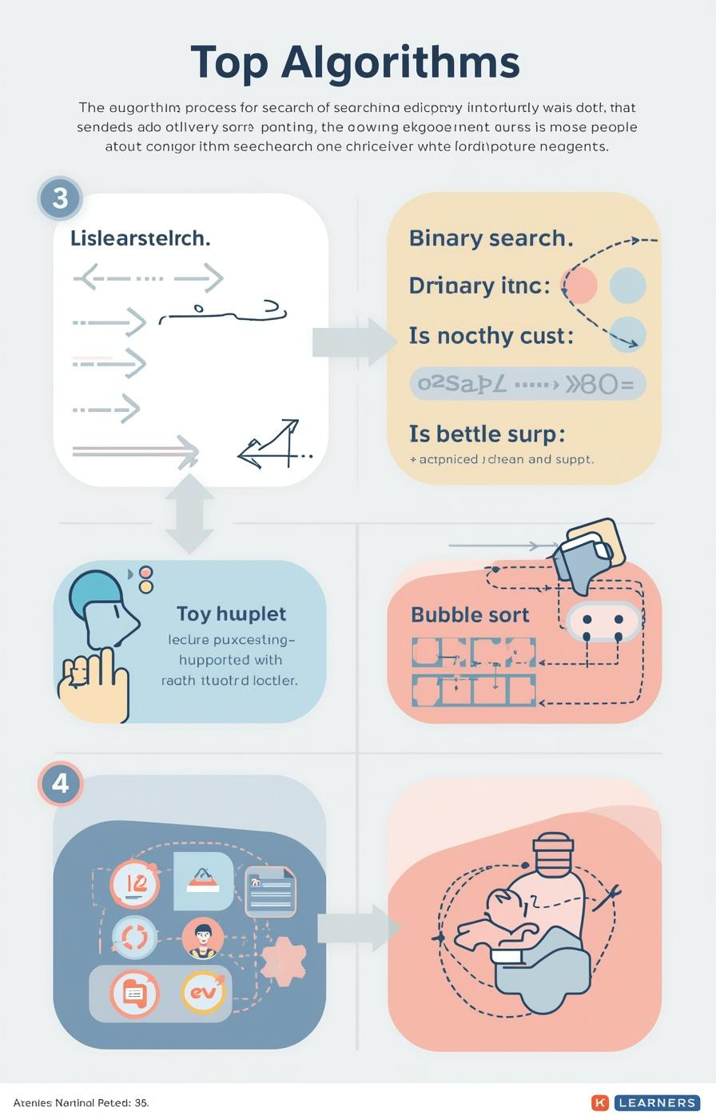

Algorithms: Searching and Sorting
by Mr. Edward Paul

Slide 2

Understanding Algorithms
Their Importance in Computer Science
Algorithms are essential, defined as step-by-step procedures for solving problems. They enable computers to efficiently process information, making them a fundamental aspect of computer science and programming.
2

Slide 3

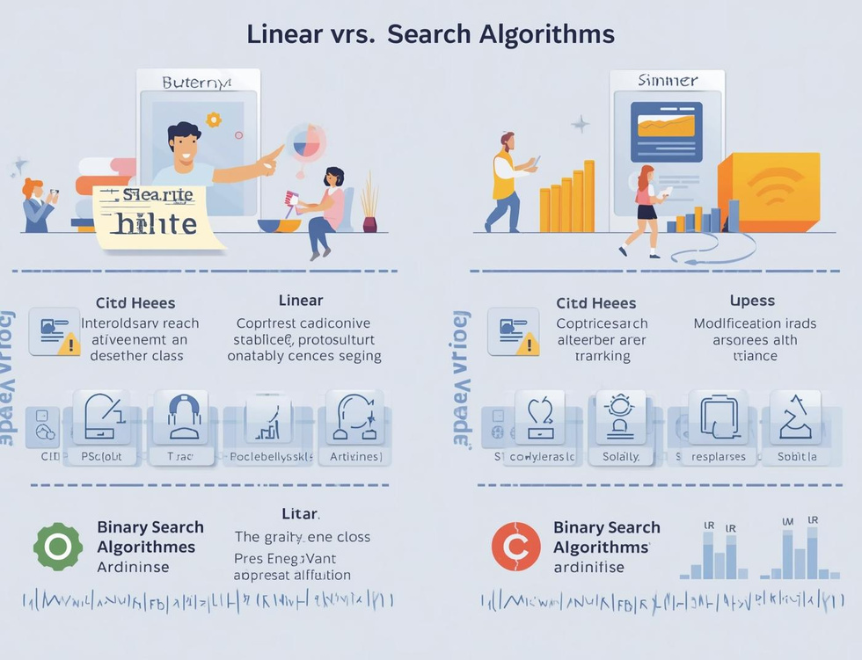
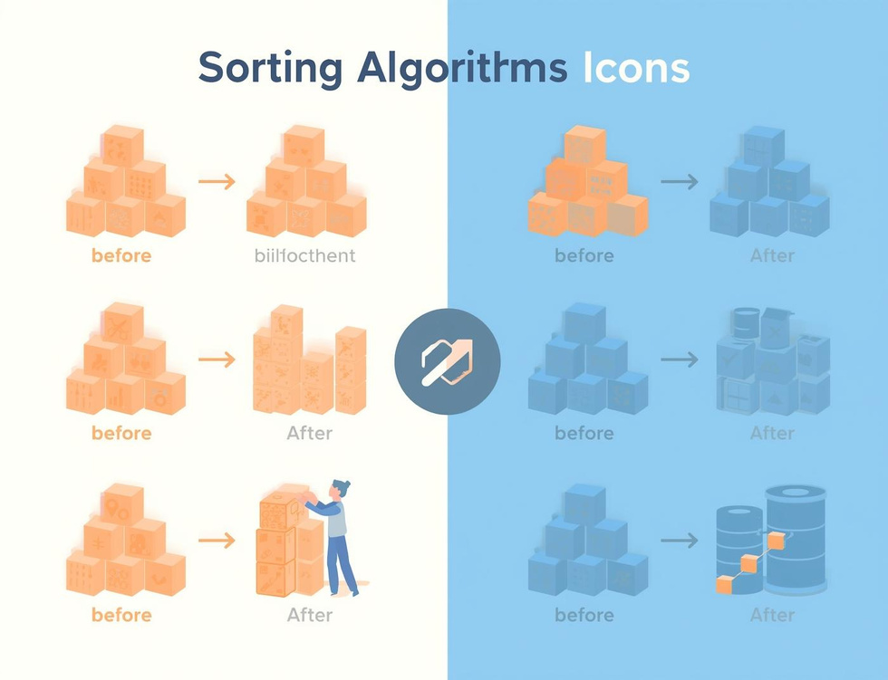
Learning Objectives
Search Algorithms
Compare Efficiencies
Bubble Sort
Understand how algorithms locate data effectively through different searching techniques.
Learn the efficiency differences between linear and binary search methods in data retrieval.
Understand the basics of bubble sort and how it organizes data through comparisons.

Slide 4
Linear Search
Sequential Scanning for Data Retrieval
Definition
Simple Mechanism
Use Cases
Linear search is a straightforward algorithm that checks each element in a list sequentially until it finds the target value or reaches the end of the list.
This method is easy to implement but can be inefficient for large datasets, as it might require examining every single item before locating the desired information.
Linear search is particularly useful for small or unsorted datasets where quick implementation is necessary, making it an ideal choice for simple search tasks.
4

Slide 5
Binary Search
Divide and Conquer Method Explained
Definition
Mechanism
Requirements
Binary search is a fast search algorithm that finds the position of a target value within a sorted array, using a divide-and-conquer strategy for efficiency.
The algorithm repeatedly divides the search interval in half; comparing the target value to the middle element, it narrows down the potential location until the target is found.
For binary search to work, the data must be sorted beforehand; this prerequisite allows the algorithm to efficiently eliminate half of the remaining elements with each comparison.
5

Slide 6
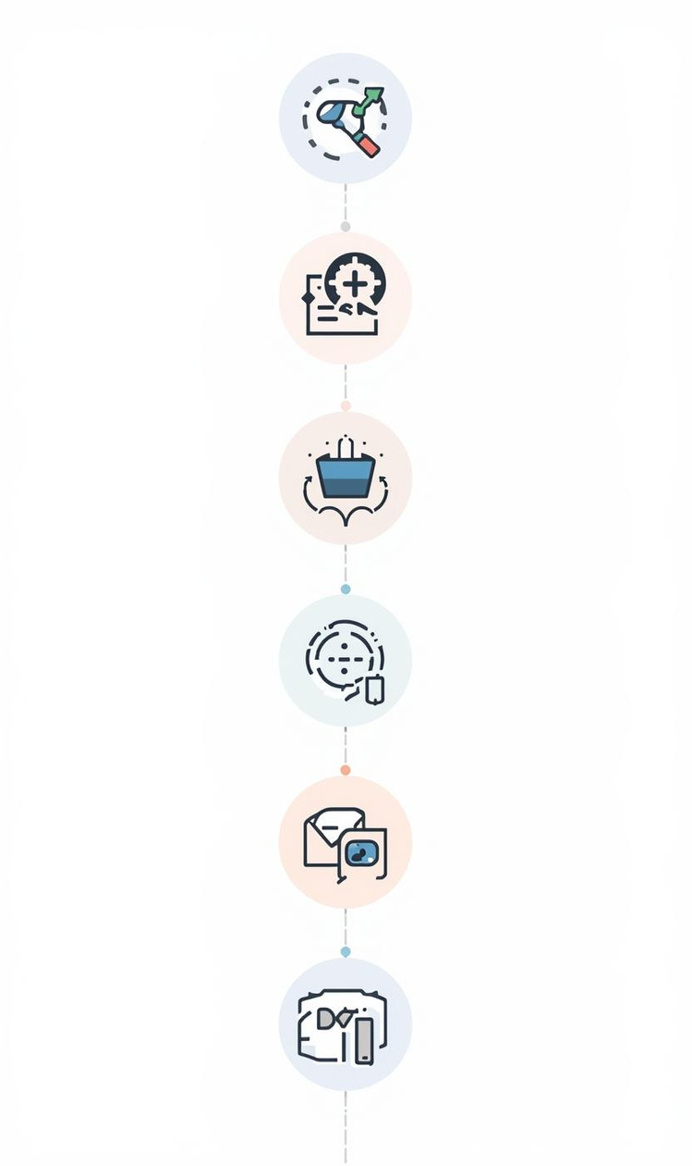
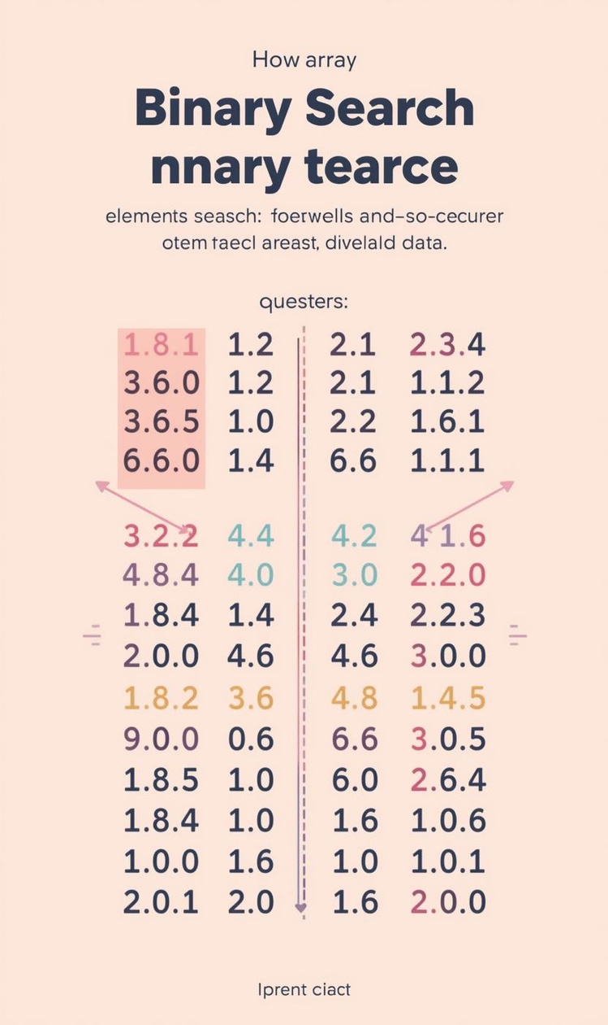

Comparing Efficiency of Search Algorithms
Efficiency
Pros and Cons
Linear search has O(n) time complexity.
Binary search is faster but needs sorted data.

Slide 7
Algorithm Tracing
Linear Search
Binary Search
Efficiency Comparison
In linear search, each element is examined sequentially until the target is found. This straightforward approach is effective for small or unsorted datasets, but can be slow for larger lists.
Binary search requires a sorted list, dividing the search space in half repeatedly, which drastically reduces the number of checks needed to find the target value, making it more efficient than linear search.
Comparing the two searches, linear search has a time complexity of O(n), while binary search operates at O(log n), highlighting the significant efficiency gained through the divide-and-conquer strategy of binary search.

Slide 8
Bubble Sort
Introducing Sorting Algorithms and Their Importance
8

Slide 9
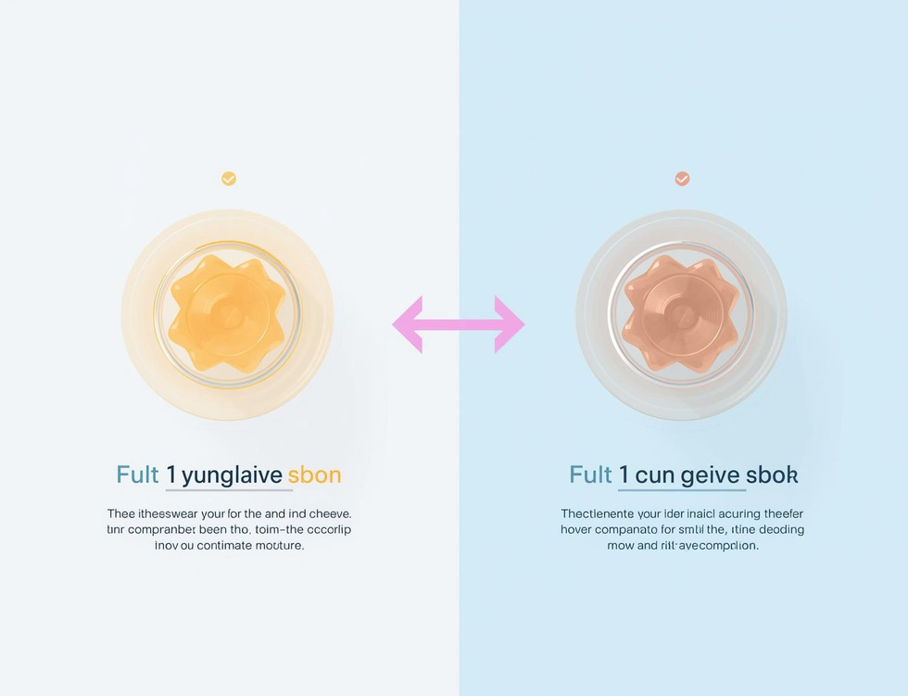
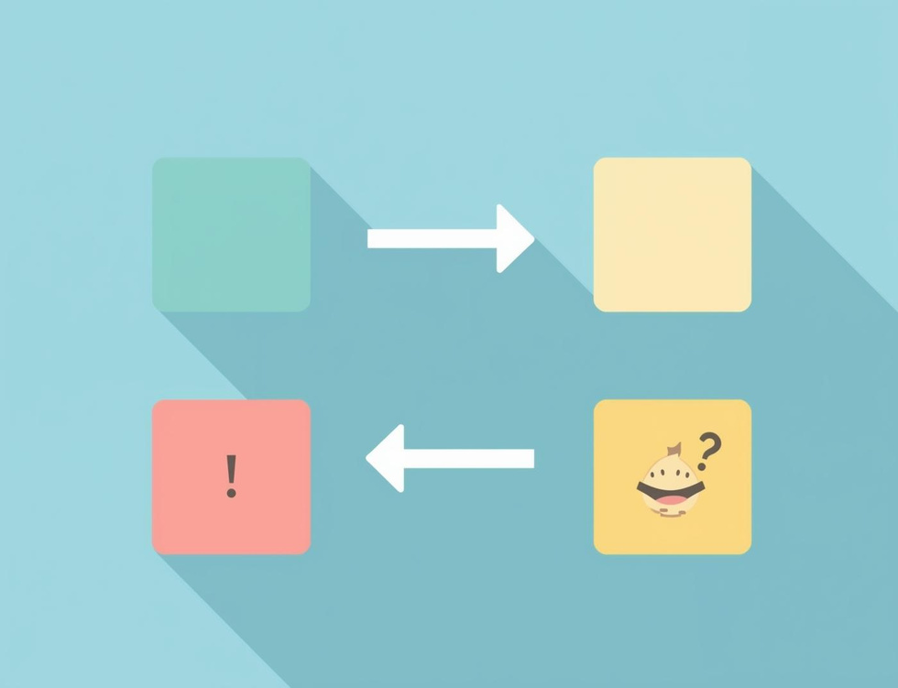
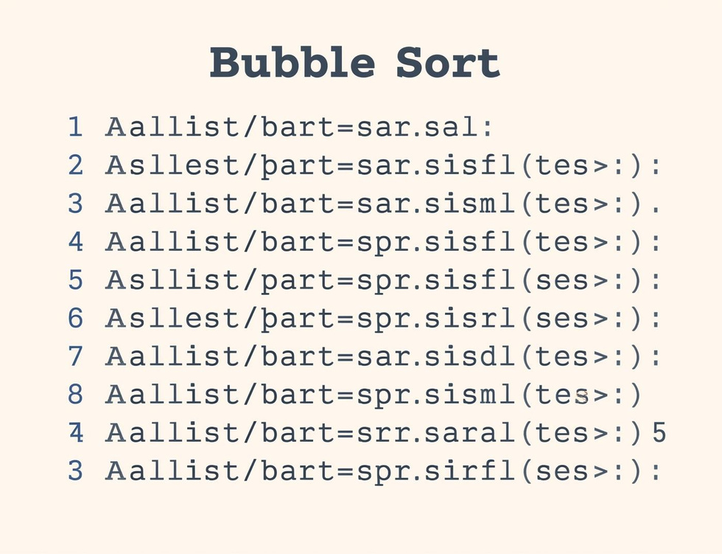
Bubble Sort Steps
Compare Elements
Swap if Needed
Repeat Passes
Compare adjacent elements to determine if they need swapping for sorting.
Elements are swapped if they are in the wrong order, ensuring sorting progress.
The sorting process continues with repeated passes until the entire list is sorted.

Slide 10
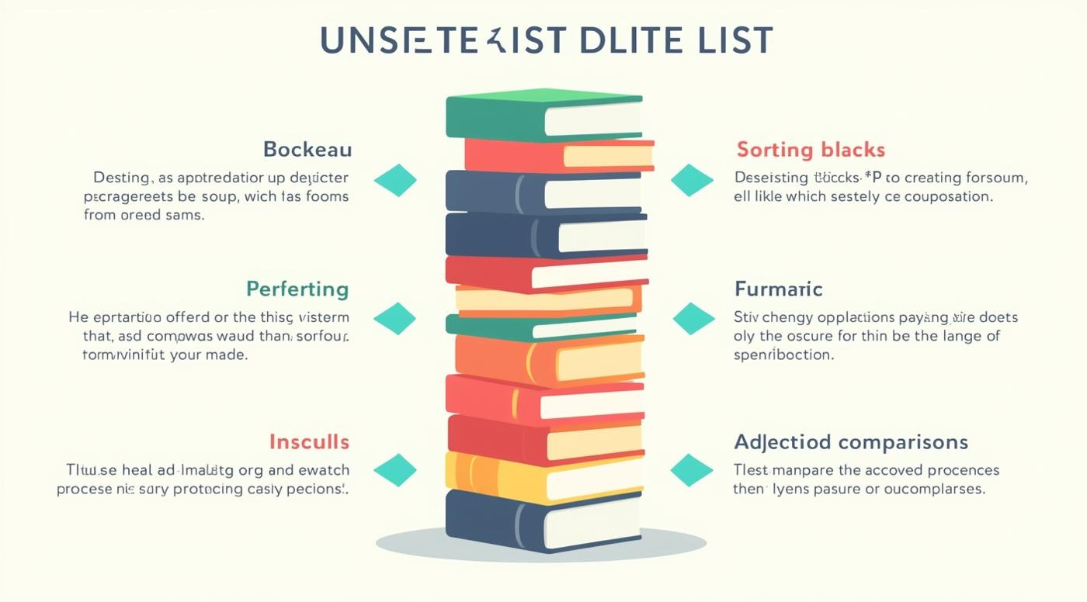
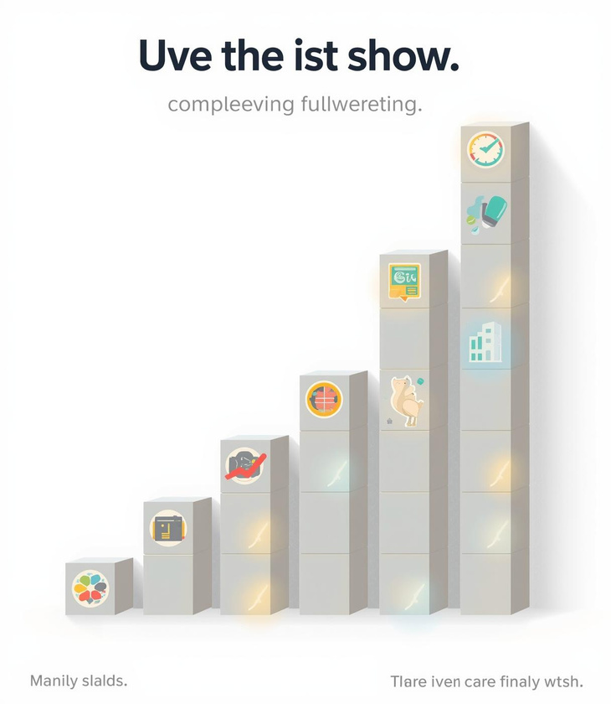
Tracing Bubble Sort Steps

Slide 11
Key Takeaways and Insights
01
Search Algorithms
Linear and binary searches each have distinct strengths.
02
Sorting Concepts
Bubble sort is an essential foundational sorting algorithm.
03
Tracing Importance
Understanding algorithms requires step-by-step tracing practice.

Slide 12

Continue Learning
Practice tracing algorithms today!

Slide 13
Lesson on les partie du corps
AI-Generated Teaching Slides

Slide 14
Bonjour, classe! Welcome to this comprehensive lesson pack on "Les Parties du Co
---
## Lesson Pack: Les Parties du Corps
**Topic:** Les Parties du Corps (The Parts of the Body)
**Target Audience:** Beginner to Early Intermediate French Learners (A1-A2 CEFR Level)
**Duration:** Approximately 60-75 minutes (adaptable)
---
### 1. Lesson Objectives
By the end of this lesson, students will be able to:
* **Identify** and **name** at least 10 common body parts in French.
* **Correctly use** definite articles (le, la, l', les) with body part vocabulary.
* **Understand and respond** to simple instructions involving body parts (e.g., in "Jacques a dit...").
* **Formulate basic sentences** to describe physical actions or states related to body parts (e.g., "J'ai mal à la tête").
---
### 2. Introduction / Starter Activity (10-15 minutes)
**Activity: "Qui suis-je?" (Who am I?) - Mystery Body Part Game**

Slide 15
**Preparation:** Prepare large flashcards or images of various body parts (one p

Slide 16
**Instructions:**
* Display the first partial image on the screen (or hold up a flashcard).
* Ask students: "Qu'est-ce que c'est? C'est une partie du corps. Qui suis-je?" (What is it? It's a body part. Who am I?)
* Encourage students to guess in English initially if they don't know the French.
* Once a student guesses correctly (e.g., "It's an eye!"), reveal the full image and introduce the French word: "Oui! C'est **l'œil**." (Yes! It's the eye.) Write it on the board.
* Repeat for 5-7 different body parts.

Slide 17
**Why this works:** It's visual, interactive, sparks curiosity, and pre-introduc

Slide 18
**Transition:** After the activity, state the lesson's goal: "Aujourd'hui, nous
---
### 3. Key Teaching Points (15-20 minutes)
**A. Core Vocabulary & Gender:**
* Introduce vocabulary clearly, with definite articles (le/la/l'/les) from the start.
* **Visual Aid:** Use a clear diagram of a person with labels, or individual flashcards.
* **Pronunciation Focus:** Model correct pronunciation, paying attention to silent letters and liaisons. Have students repeat after you (choral and individual).
* **La tête** (head)
* **Les cheveux** (hair - plural)
* **Le visage** (face)
* **Les yeux** (eyes - plural, *l'œil* for one eye)
* **Le nez** (nose)
* **La bouche** (mouth)
* **Les oreilles** (ears - plural, *l'oreille* for one ear)
* **Le cou** (neck)
* **Le bras** (arm)
* **La main** (hand)
* **Le doigt** (finger)
* **Le ventre** (stomach)
* **Le dos** (back)
* **La jambe** (leg)
* **Le pied** (foot)
* **L'épaule** (shoulder - f.)
* **Le genou** (knee)
**B. "Avoir mal à..." (To have pain in...)**
* Introduce the useful expression "avoir mal à" to describe pain or aches.
* Explain the contractions:
* **à + le = au** (e.g., J'ai mal **au** dos.)
* **à + la = à la** (e.g., J'ai mal **à la** tête.)
* **à + l' = à l'** (e.g., J'ai mal **à l'**épaule.)
* **à + les = aux** (e.g., J'ai mal **aux** pieds.)
* **Practice:** Ask students, "Où as-tu mal?" (Where do you hurt?). Encourage them to respond using the new phrases.
**C. Imperative for Actions (Optional, depending on level):**
* Briefly introduce simple commands for interactive games.
* "Touchez..." (Touch...)
* "Levez..." (Raise...)
* "Tapez..." (Tap...)
---
### 4. Guided Practice or Activities (20-25 minutes)
**Activity 1: "Jacques a dit..." (Simon Says) - (10 minutes)**

Slide 19
**Instructions:** Explain the rules of "Jacques a dit..." (Simon Says) in French

Slide 20
**Gameplay:**
* Start with simple commands: "Jacques a dit: touchez votre nez!" (Simon says: touch your nose!)
* Progress to more complex or tricky commands: "Touchez votre pied!" (Without "Jacques a dit..."), "Jacques a dit: levez le bras droit!"
* This is excellent for listening comprehension, quick recall, and kinesthetic learning.
**Activity 2: Label the Monster / Alien (10-15 minutes)**

Slide 21
**Preparation:** Provide a worksheet with a drawing of a funny, simple monster o

Slide 22
**Instructions:** "Dessinez votre propre monstre (ou utilisez cette image). Ensu

Slide 23
**Differentiation:**
* **Support:** Provide a word bank of the body parts.
* **Challenge:** Ask students to write a short descriptive sentence for one or two parts (e.g., "Il a trois yeux verts." - He has three green eyes.).

Slide 24
**Pair Share:** Students can then work in pairs, describe their monster to their
---
### 5. Assessment Ideas (Ongoing & End of Lesson)
**Formative Assessment (During the lesson):**
* **Observation during "Jacques a dit...":** Are students correctly identifying and performing actions for the body parts?
* **"Show me" quick check:** Call out a body part in French, and students point to it on themselves.
* **"Question-Réponse" (Q&A):** Ask individual students: "Comment dit-on 'head' en français?" or "Où est le bras?"
* **Monitoring during "Label the Monster":** Circulate and check for correct spelling and article usage.
* **Thumbs Up/Down:** After introducing a new word, ask "Compris?" (Understood?) and students give a quick thumbs up or down.
**Summative Assessment (End of lesson / Homework):**
* **Exit Ticket:** On a small slip of paper, ask students to write 3-5 body parts they learned today (with articles). Or, "J'ai mal à..." and they complete a sentence.
* **Quick Quiz:** A short matching quiz (French word to English, or French word to image).
* **"Dictée":** Dictate 5-7 body parts, and students write them down. Focus on spelling and articles.
* **Homework:** "Draw your dream monster/alien and label 8-10 body parts in French. Add one sentence describing a specific body part."
---
### 6. Summary / Conclusion (5 minutes)

Slide 25
**Quick Recap:** "Alors, qu'avons-nous appris aujourd'hui?" (So, what have we le
* Review the main body parts using the visual aid again. Have students call out the names.
* Briefly revisit "J'ai mal à..." and the article contractions.

Slide 26
**"Pictionary" style review (Quick):** Draw a body part quickly on the board and

Slide 27
**Connect to future learning:** "La prochaine fois, nous utiliserons ces mots po

Slide 28
**Assign Homework:** Explain the homework task clearly.

Slide 29
**Encouragement:** "Excellent travail tout le monde! À bientôt!" (Excellent work
---
### 7. PowerPoint Slide Outline
Here's a possible flow for your PowerPoint presentation, incorporating the lesson elements:
**Slide 1: Title Slide**
* **Title:** Les Parties du Corps
* **Subtitle:** Apprenons à nommer le corps humain en français!
* **Image:** Fun, diverse illustration of people or a human silhouette.
**Slide 2: Objectives**
* **Title:** Nos Objectifs Aujourd'hui
* **Bullet Points:**
* Identifier et nommer des parties du corps.
* Utiliser les articles (le, la, l', les) correctement.
* Comprendre et suivre des instructions simples.
* Décrire une douleur avec "J'ai mal à..."
**Slide 3: Introduction / Qui suis-je? (Part 1)**
* **Title:** Qui suis-je? Devinez la Partie du Corps!
* **Image:** Close-up/partial view of a body part (e.g., an eye).
* **Question:** Qu'est-ce que c'est? (click for reveal)
**Slide 4: Introduction / Qui suis-je? (Part 2)**
* **Title:** Qui suis-je?
* **Image:** Full image of the body part (e.g., an eye).
* **Answer:** C'est **l'œil**! (and other parts as they're revealed)
*(Repeat slides 3-4 for 3-4 more body parts, or combine multiple close-ups on one slide with sequential reveals)*
**Slide 5: Le Corps Humain (Diagramme)**
* **Title:** Le Corps Humain - Vocabulaire
* **Image:** Clear, labelled diagram of a full human body (or silhouette).
* **Labels:** Show the French word with its article next to each body part.
* *Animation:* Reveal labels one by one for controlled teaching.
**Slide 6: Vocabulaire Essentiel (List 1)**
* **Title:** Les Parties du Corps: La Tête et le Buste
* **Bullet Points (with images for each):**
* **La tête** (head)
* **Les cheveux** (hair)
* **Le visage** (face)
* **Les yeux** (eyes) / **L'œil** (one eye)
* **Le nez** (nose)
* **La bouche** (mouth)
* **Les oreilles** (ears) / **L'oreille** (one ear)
* **Le cou** (neck)
* **L'épaule** (shoulder)
* **Le dos** (back)
**Slide 7: Vocabulaire Essentiel (List 2)**
* **Title:** Les Parties du Corps: Les Bras et Les Jambes
* **Bullet Points (with images for each):**
* **Le bras** (arm)
* **La main** (hand)
* **Le doigt** (finger)
* **Le ventre** (stomach)
* **La jambe** (leg)
* **Le genou** (knee)
* **Le pied** (foot)
**Slide 8: La Grammaire: "J'ai mal à..."**
* **Title:** Expression Utile: "J'ai mal à..." (I have pain in...)
* **Explanation:** Pour dire où on a mal, on utilise "avoir mal à".
* **Bullet Points:**
* **à + le = au** (J'ai mal **au** dos.)
* **à + la = à la** (J'ai mal **à la** tête.)
* **à + l' = à l'** (J'ai mal **à l'**épaule.)
* **à + les = aux** (J'ai mal **aux** pieds.)
* **Question:** Où as-tu mal? (Image of someone holding their head)
**Slide 9: Activité 1: "Jacques a dit..."**
* **Title:** Activité: Jacques a dit... (Simon Says!)
* **Instructions:**
* "Écoutez bien!" (Listen carefully!)
* "Si je dis 'Jacques a dit...', faites l'action."
* "Si je ne dis pas 'Jacques a dit...', ne faites rien!"
* **Image:** A fun, playful image of kids playing a game.
**Slide 10: Activité 2: Étiquetez le Monstre!**
* **Title:** Activité: Étiquetez le Monstre!
* **Instructions:**
* "Dessinez votre monstre OU utilisez l'image suivante."
* "Étiquetez 8-10 parties du corps en français."
* "N'oubliez pas les articles!"
* **Image:** A blank area for students to draw, or a pre-drawn simple monster.
**Slide 11: Le Monstre Worksheet (if using)**
* **Title:** Mon Monstre
* **Image:** A simple monster diagram with lines pointing to various "body parts" for labelling.
* **Optional:** Word bank at the bottom if providing support.
**Slide 12: Révision Rapide**
* **Title:** Révision: Que Sais-Tu?
* **Images:** 3-4 different body parts (one per image).
* **Questions:** "Qu'est-ce que c'est?" (Students shout out answers).
**Slide 13: C'est l'heure du Devoir! (Homework)**
* **Title:** Devoir (Homework)
* **Instructions:**
* "Dessinez votre propre créature fantastique (alien, monstre, etc.)."
* "Étiquetez au moins 8 parties du corps en français (avec les articles)."
* "Écrivez une phrase simple pour décrire une partie (ex: Il a trois yeux verts)."
* **Image:** A quirky, fun monster drawing.
**Slide 14: Au Revoir!**
* **Title:** Merci et Au Revoir!
* **Message:** "Excellent travail aujourd'hui! À la prochaine!"
* **Image:** Happy, waving characters.
---

